Slide 1
Student Reflections on MDE Public Hearing on Academic Standards for Social Studies on January 28, 2022
Notes:
Ms. Drake

Slide 2
Introduction and Purpose
Teacher: Alexandria Drake
-JPS-Tougaloo ECHS, US History
-B.S. Social Science Edu.; Jackson State Univ.
-M.A. African and African Diaspora Studies,
Univ. of Texas at Austin
Students: Arianna Brumfield, Arielle Brumfield, Lynzi Davis, JohnAnna Esters, Jermarius Everett, Whitney Jones, Richeen Neal, Aznii Welchlin
Notes:
Ms. Drake

Slide 3
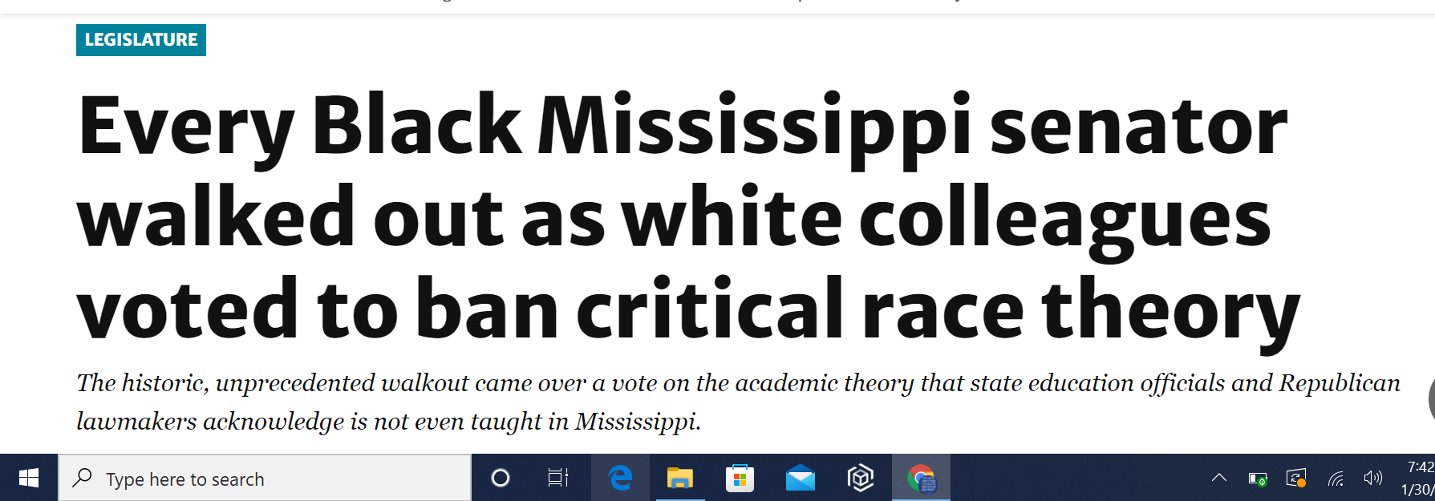
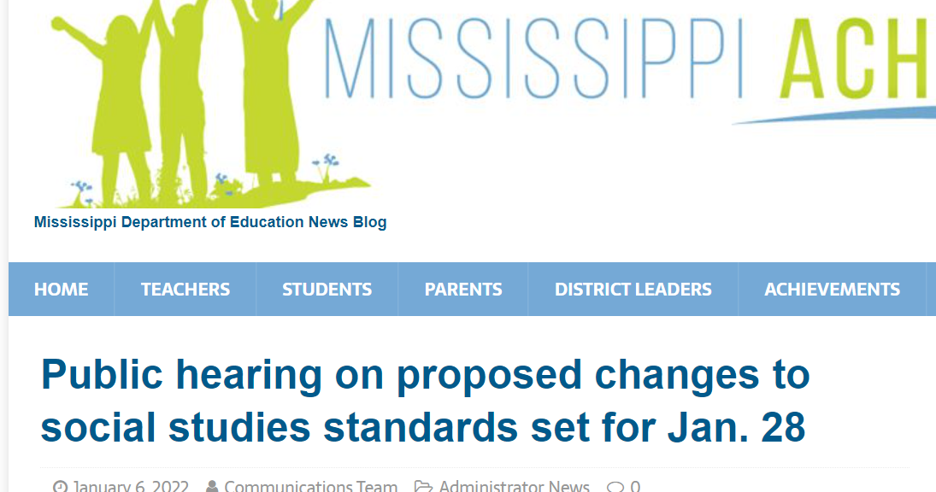
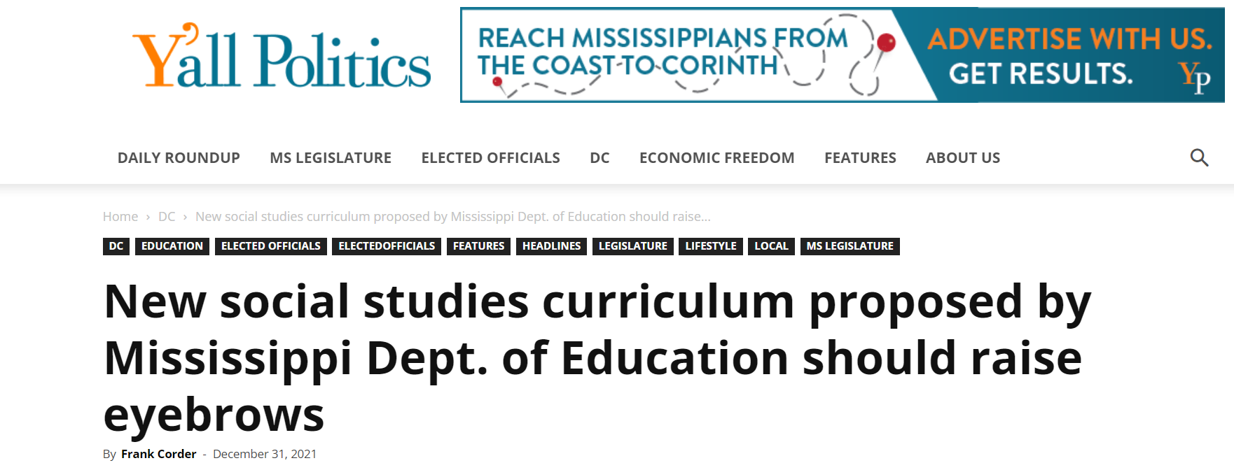
Recent focus on MS Social Studies Curriculum in the Media
Notes:
Ms. Drake

Slide 4
Examples of Standards that originally raised concern:
Notes:
Ms. Drake

Slide 5
Student Reflections on Public Hearing
Noticed lack of diversity in crowd at hearing. Those that would be impacted by the removal of Civil Rights Standards were not well represented.
Noticed that the tone of the hearing seemed aggressive and intimidating (ex. The audience booed certain speakers).
There was a push for patriotism (honoring constitution as is) over seeing constitution as a “living document”.
Push for curriculum to reflect Christian values in school (ex. prayer in schools).
Participants equated Critical Race Theory to Social and Emotional Learning Curriculum (SEL).
Notes:
Lynzi Davis and Richeen Neal

Slide 6
Student Reflections on Public Hearing
There was a push for uniformity instead of celebrating diversity.
There was concern that certain labor unions were omitted from parts of the standards.
Reflection Summation:
Since there have been strong beliefs about race since the founding of the nation, we can not evade those origins. If we become more polarized in our beliefs and do not make an effort to unify and compromise, recent examples of civil unrest may continue to occur.
Notes:
Kyita Welchlin and Jermarius Everett

Slide 7
What is Critical Race Theory?
“The core idea is that race is a social construct, and that racism is not merely the product of individual bias or prejudice, but also something embedded in legal systems and policies.”
(Sawchuk, 2018)
Notes:
Arianna B.

Slide 8
Moving Forward, we, the students ask…
that we be given a seat at the table on the district and state level when decisions are made that impact us.
for more specificity in the standards. Without this there will be no common body of knowledge in Mississippi.
to be seen in the curriculum.
to be encouraged to think
critically.
to be allowed to find the balance between patriotism and questioning our country’s past and present.
that all schools get involved in forums such as this.
that this school board genuinely considers supporting the retention of Civil Rights standards as they are this year.
for other students to join us in responding to MDE’s request for written feedback regarding proposed changes to the
standards.
Notes:
Arielle Brumfield, JohnAnna Esters, Whitney Jones

Slide 9
Feedback about the Mississippi College and Career Readiness Standards for Social Studies 2021 may also be submitted to the MDE in writing via email, jcornett@mdek12.org
or
mailed to Mississippi Department of Education Attn: Jen Cornett, K - 12 Social Studies Director P.O. Box 771, Jackson, MS 39205

